Slide 1

B.Sc.Engg. In (CSE)
Level 2 Semester IV Math-221
Credit: 3.00 Marks: 100
Laplace Transform
(Properties)
Mehetaj parvine
Lecturer
Mathematics Department
Patuakhali Science and Technology University
Email: mehetajparvine@gmail.com
Cell: 01747792047
19-04-2021

Slide 2
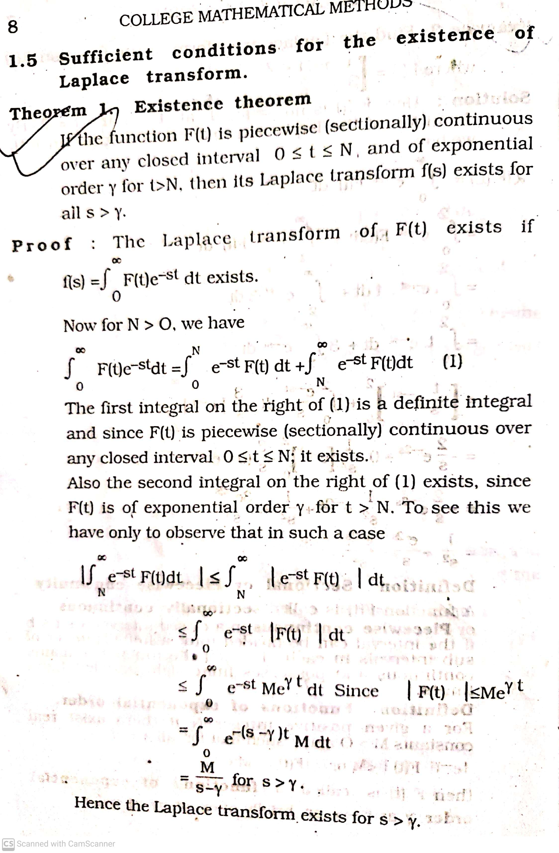

Slide 3
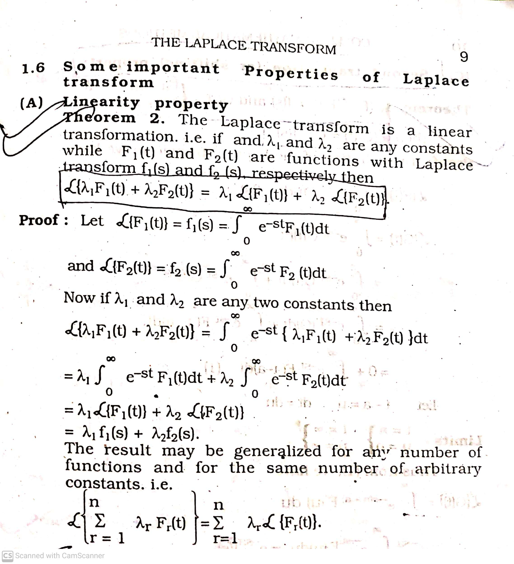

Slide 4
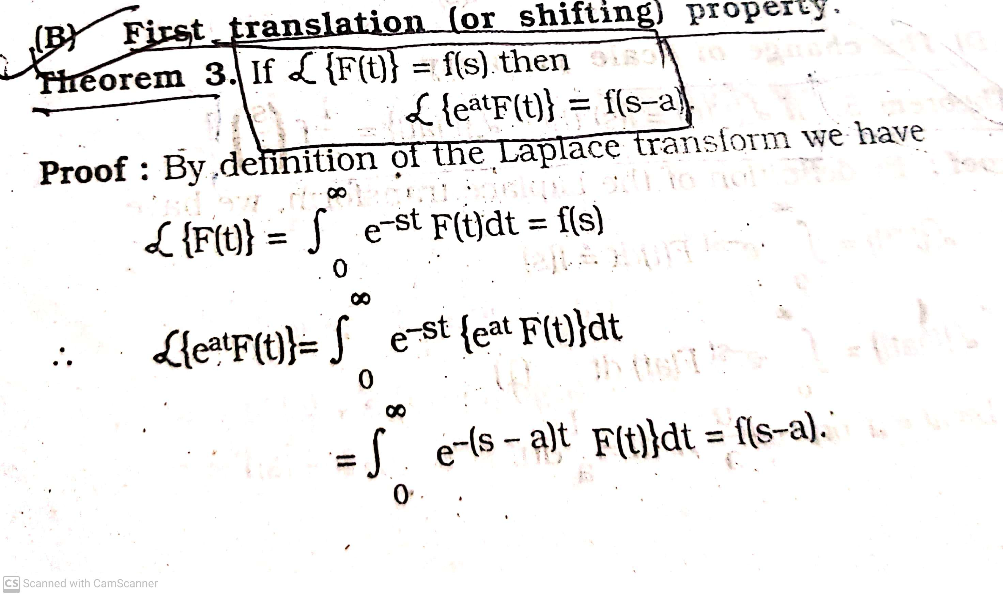

Slide 5
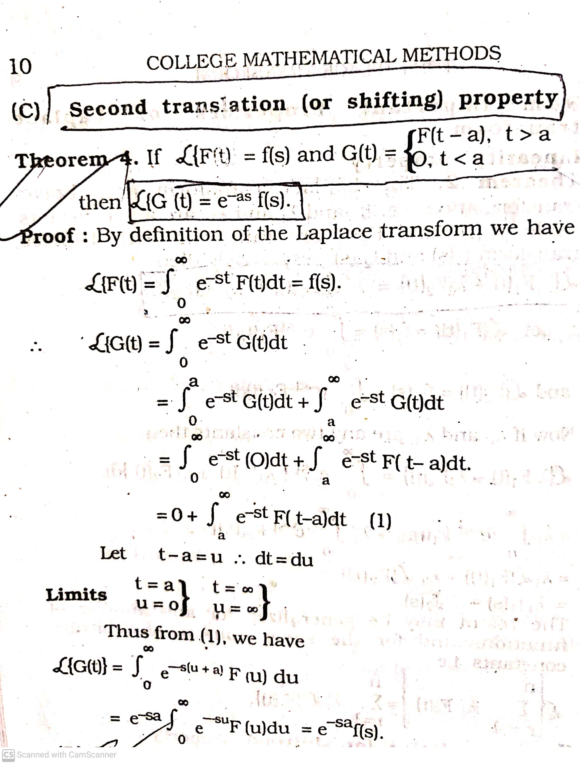

Slide 6
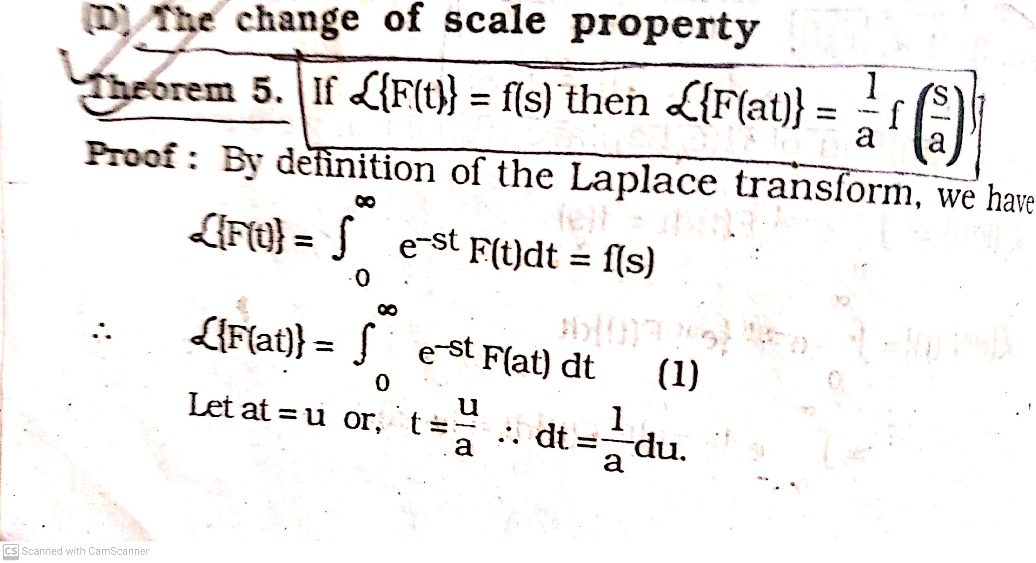

Slide 7
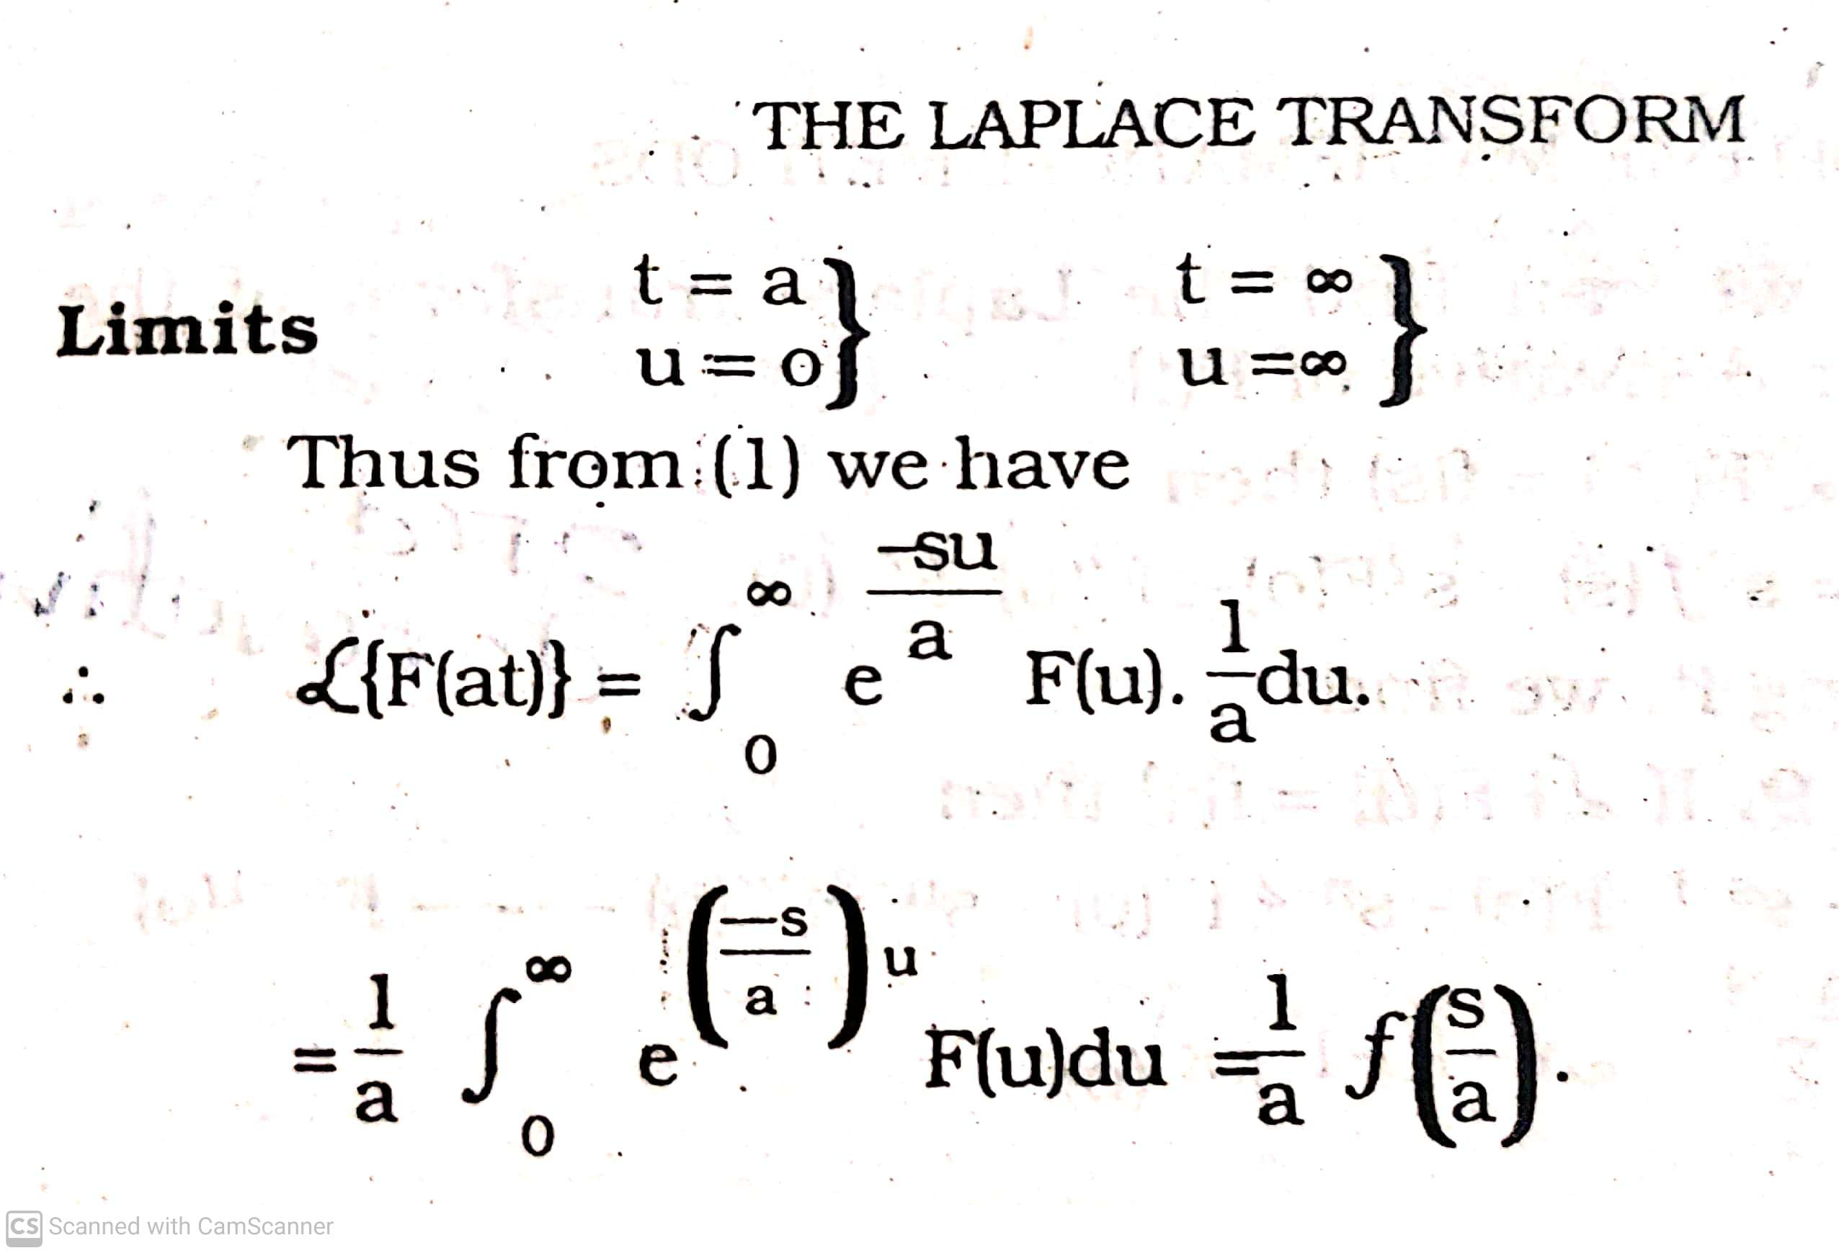

Slide 8
Thank you

